Slide 1
CDP409 – Using Docker Containers
July, 2017
Benny Bustan
Principal Technology Development

Slide 2
You are HERE!
CDP101 – Introduction to MicroServices
CDP202 – Domain Driven Design
CDP103 – Introduction to the Continuous Deployment Platform
CDP104 – Introduction to Standard Tools and Frameworks
CDP205 – Using the MicroServices Catalog
CDP206 – Developing an Application Using MicroServices
CDP207 – Developing MicroServices
CDP308 – MicroServices Problem Determination and Monitoring
CDP409 – Using Docker Containers
CDP410 – Using Kubernetes
101
202
103
104
205
206
207
You are HERE
308
409
410

Slide 3
Quick View Page
Your Course Outline
Docker Containers: Overview
Introduces the basic concept of Dockers containers.
Dockerfile
How to create Docker Image
Docker Container Commands
How to manage and deploy Docker containers
AT&T Eco – AJSC6 Pipeline
AJSC6 Pipeline flow
Your Course Overview
This course explains how Docker containers are being used part of CDP runtime environment and especially when using AJSC6. This course explains advanced concepts that a developer may want or need to understand to take advantage of some advanced capabilities of Docker containers. This course provides more detailed information about Docker. You can work through the course at your own pace. It may take 1 to 2 hours to complete this course, including the self-check exercises.
Intended Audience
Operations , Developers , Architects
Prerequisites
None

Slide 4


Before You Start
You’ll need to see both the slide and the notes section below. If you don’t see the notes section, click on “Notes Page” within the “View” tab. If viewing the presentation as a slide show, you may also see the notes on the presenters page.
Notes are not visible using the PowerPoint Viewer.
Notes:
These slides have a significant amount of notes added to them to explain the content. This is done so that reading the notes is essentially what an instructor leading the course would have said. There is a good amount of explanation in the notes that may be missed if you look only at the slide.
The notes can be viewed using several different approaches. If you are viewing the presentation as a slide show, the presenters view will show the slide and the notes. If you have opened the presentation in PowerPoint, you can view the notes using one of several means:
Select the “View” menu, then select “Notes Page”
In the normal view, use your mouse to select a divider along the bottom of the slide and move it up. This will show both the slide and the notes.
Please note, if you are using the power point viewer, the notes will not be visible. You will need to use PowerPoint to view the presentation content in its entirety.

Slide 5
Contents
Docker Containers: Overview
Dockerfile
Docker Container Commands
AT&T Eco – AJSC6 Pipeline

Slide 6
Introduction
Why this Training?
The purpose of this training is to provide in-depth Docker technology training as it relates to the CDP framework.
Docker container technology is widely used as part of the AT&T ECO microServices runtime environment.
Docker Containers: Overview
Notes:
This course is going to introduce you to Docker containers technology which is part of the Runtime environment used by CDP to perform the CI/CD processes for microServices.
This course focuses on deep understanding of what is Docker containers and how it is being used in CDP. This course also contains examples taking from AJSC6 Docker deployment using AT&T ECO.

Slide 7

An Docker Containers: Overview
Why Docker containers?
Almost no performance impact to application
Docker is nearly identical to native performance and faster than KVM in every category.
Docker isn't virtualization, and as such is lighter then any Virtual Machine.
Almost no performance impact for applications
Docker Containers: Overview
Notes:
Before we start going into a deeper understanding about how Docker containers are being built and used in CDP….
…here’s a quick recap of the main advantages of using Docker containers:
First, there isn’t any impact on the performance of our application when running as a Docker container…meaning, it won’t effect your application’s performance.

Slide 8
An Docker Containers: Overview
Why Docker containers?
Ability to pack applications, configuration files, pre-requisites, etc., in a Docker image for easy distribution and deployment
The same Docker image can be executed in multiple environments.
Easy packaging
Docker Containers: Overview
Notes:
Second, Docker containers technology allow you to easily pack all relevant 3rd parties, your code, and other application-specific files in one image.
This simplifies the deployment into one artifact.

Slide 9
An Docker Containers: Overview
Why Docker containers?
The same host can host different types of Docker containers running different Linux versions.
For example, if you have a Legacy product that has to run on Red Hat 5.X and, in parallel, you’re developing new microService that is runs on Red Hat 7.X, both can run on the same host.
Ability to run different Linux versions in the same host system
Docker Containers: Overview
Notes:
Third, the same host can host different types of Docker containers that are running different Linux versions.
For example, if you have a Legacy product that has to run on Red Hat 5.X and, in parallel, you’re developing new microService that is runs on Red Hat 7.X, both can run on the same host each on different Docker container.

Slide 10
An Docker Containers: Overview
Why Docker containers?
Single command deployment
No post configuration is needed
Easy rollback.
Rapid Deployment
Easy packaging
Docker Containers: Overview
Notes:
Fourth, the Docker deployment is fast and only takes a few commands to execute.
Once Docker image has being created it can easily deployed on your Development, Testing and Production in single command.
Rollback is also easy just loading the previous Docker Image.

Slide 11
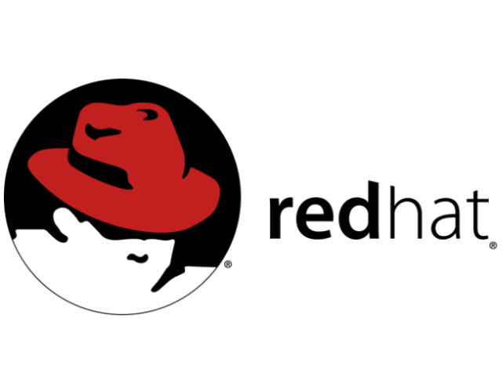
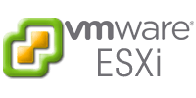
Traditional AJSC5 Java Application Architecture in ITO Cloud
An Docker Containers: Overview
AJSC5 Application
AJSC5 Application
AJSC5 Application
JAVA Runtime Environment
LRM/DME2
Operating System
Infrastructure
Docker Containers: Overview
Notes:
Before we start understanding how CDP builds and deploys Docker, it is important to understand the ITO Cloud architecture.
Here, I divided it into layers.
In this example you can see a AJSC5 Java application deployment without Docker:
First layer – Infrastructure – the ITO Cloud virtual machines
Second Layer - Operating systems - Red Hat 6.X or Red Hat 7.X
Third Layer - 3rd Parties - JRE - the JAVA Runtime environment and LRM & DME. The SOA Cloud components are usually installed using SWM packages.
Fourth Layer - Application Layer - AJSC5 – the Java application installed using the SWM package.

Slide 12

AJSC6 Container Architecture in ITO Cloud
An Docker Containers: Overview
AJSC6 Application
AJSC6 Application
GRMEdge
JRE 8
DME2
JRE 8
DME2
JRE 8
DME2
alpine-java:8_jdk
alpine-java:8_jdk
alpine-java:8_jdk
Docker Engine / Kubernetes Cluster
Operating System
Docker Containers: Overview
Infrastructure
Notes:
Now, here’s how the new ITO deployment will look when using CDP. It will contain the same number of layers, but organized a bit differently.
First Layer - Infrastructure – Virtual Machine
Second Layer - Operating systems – Red Hat (Red Hat version 7.X is a must. Docker engine can’t be installed on lower versions then 7.X).
Third Layer - Docker Engine / Kubernetes Cluster
Docker engine responsible for the communication between the Docker containers to the host kernel, and
Kubernetes is responsible for orchestration of the Docker containers deployment, high availability, configuration and networking.
Fourth Layer - Docker containers - multiple containers running different microServices, each contains the following:
Base Image – lightweight OS running inside the container
3rd Parties – JRE, DME and etc., installed on top of the Base image
AJSC6 Java Application - installed on top of the Base image

Slide 13
An Docker Containers: Overview
Docker containers encapsulation
Our traditional deployment automation usually involves:
Installing 3rd parties
Adding specific configuration
Deploying our application as SWM packages
All of this can be encapsulated as part of the Jenkins pipeline into one artifact called the “Docker image.”
This image can be deployed on any host running Docker engine / Kubernetes.
Docker Containers: Overview
Notes:
CDP uses a system integration approach to CI/CD, using the best tools available for each of the tasks in implementing CI/CD.
These tools are integrated together by the CDP infrastructure and used to implement the CI/CD process the way we need it to operate.
AT&T Eco is part of CDP, and during the AT&T Eco pipeline, the Docker image is being created and deployed to Staging/Production.

Slide 14

Check Your Progress

Slide 15
Exercises
A+
Docker Containers: Overview
What are the main benefits of using Docker containers? (Make more than one choice.) | Rapid deployment Ability to run different Linux versions in the same host system Infrastructure management Almost no performance impact to applications Easy packaging
Docker engine is supported on all Red Hat Linux versions. | True/False
Notes:
Docker Containers: Overview
Dockerfile
Docker Container Commands
AT&T Eco – AJSC6 Pipeline

Slide 16
Exercises
A+
Docker Containers: Overview
Match Layer to function for an AJSC6 Container Architecture in ITO Cloud:
Layer Three | Infrastructure – Virtual Machine
Layer Two | Operating systems – Red Hat
Layer Four | Docker Engine / Kubernetes Cluster
Layer One | Docker containers

Slide 17
Contents
Docker Containers: Overview
Dockerfile
Docker Container Commands
AT&T Eco – AJSC6 Pipeline

Slide 18
Dockerfile
The 5 Building Blocks
Choose Base Image
Create Dockerfile
Build Image
Upload Image to AT&T Registry
Start Container
Dockerfile
Notes:
Before we’re going to look at AJSC6 Dockerfile it is important to understand the Docker containers build and runtime steps.
We divided the steps into 5 building blocks.
A bakery can be used as an example:
First Step - Choose your Base Image – The container requires an OS. This is called the “Base Image."
It is the OS running inside the container, and many vendors have already created light-weight images that can be used, such as Centos, Apache and more.
In AJSC6, we’re using Base Image from Alpine distribution.
Looking at a bakery, this would be like choosing which type of cake you want to bake…..cheesecake, chocolate, marble, etc..

Slide 19
Dockerfile
Where is the Base Image found?
When using an AJSC6 container, it uses the Alpine distribution Java 8 Base Image.
The Base image is retrieved from the AT&T Docker hub - https://dockercentral.it.att.com:5100 during Docker Build phase.
Other public base images can be downloaded from Docker hub https://hub.Docker.com.
Dockerfile

Slide 20
Dockerfile
The 5 Building Blocks
Choose Base Image
Create Dockerfile
Build Image
Upload Image to AT&T Registry
Start Container
Dockerfile
Notes:
Now that we have our Base Image, here is the next step create the Dockerfile.
First Step – Completed - Choose your Base Image.
The container requires an OS. This is called the “Base Image."
It is the OS running inside the container, and many vendors have already created light-weight images that can be used, such as Centos, Apache and more.
In AJSC6, we’re using Base Image from Alpine distribution.
Looking at a bakery, this would be like choosing which type of cake you want to bake, cheesecake, chocolate, marble, etc..
Second Step - Create a Dockerfile – A Dockerfile is a text document that contains all the commands a user can call upon to assemble an image.
Looking at a bakery, this similar to a cake recipe.

Slide 21
Dockerfile
What is a Dockerfile?
Is a text document that contains all the commands a user could call, on the command line, to assemble an image.
Docker build command will execute all those command and create a new Docker image we can use to run our containers
Where can I find my AJSC6 Dockerfile?
After a successful creation of new pipeline using AT&T ECO, you can find the Dockerifle on your code repository under src/main/Docker.
Dockerfile

Slide 22
Dockerfile
Dockerfile Example #1 – Running Java Hello World.
# Base Image location
FROM anapsix/alpine-java
# Copy the HelloWorld.jar file from our local directory to the image
COPY HelloWorld.jar /home/HelloWorld.jar
# Run a command on the filesystem of the image to run the HelloWorld JAR File.
CMD ["java","-jar","/home/HelloWorld.jar"]
Dockerfile
Notes:
Docker runs instructions in a Dockerfile in order.
The first instruction must be `FROM` in order to specify the Base Image from which you are building.
Docker treats lines that begin with # as a comment, unless the line is a valid parser directive.
A # marker anywhere else in a line is treated as an argument.
In this example we’re using Docker container to run HellowWorld.jar file, the Dockerfile commands we’re using are:
FROM – The Base Image contains Oracle Java 8 (and 7) with GLIBC 2.23 over Alpine Linux.
COPY – Copy the HelloWorld.jar file into the image from your build server host.
CMD – Default command to run when running the container, in our case running the HelloWorld.jar file.

Slide 23
Dockerfile
Dockerfile Example #2– Running Apache server
# Base Image location
FROM ubuntu:12.04
# Install apache using apt-get
RUN apt-get update && apt-get install -y apache2 && apt-get clean && rm -rf /var/lib/apt/lists/*
# Setup environment variable inside the container
ENV APACHE_RUN_USER www-data
ENV APACHE_RUN_GROUP www-data
ENV APACHE_LOG_DIR /var/log/apache2
# Make port 80 available
EXPOSE 80
# Run a command on the filesystem of the image to start the apache.
CMD ["/usr/sbin/apache2", "-D", "FOREGROUND"]
Dockerfile
Notes:
In this example we’re using Docker container to run apache server.
The Dockerfile commands we’re using are:
FROM – The Base Image contains Ubuntu version 12.04
RUN – Run a command inside the container, in our case running apt-get to install the apache application.
ENV – Set environment variable in the container, in our case we’re setting 3 different environment variables.
EXPOSE – Expose ports from the container, using this command we can later bind a host port to the container port.
CMD – Default command to run when running the container, in our case running the apache application

Slide 24
Dockerfile
Dockerfile Example #3– AJSC6 Dockerfile
# Base Image location
FROM zlp11313.vci.att.com:5100/com.att.ajsc/anapsix/alpine-java:8_jdk
# Create mount point
VOLUME /tmp
# Add files to the filesystem of the image
ADD tmlaapitest4-0.0.1-SNAPSHOT.jar app.jar
# Create mount point
VOLUME /etc
# Add files to the filesystem of the image
ADD /etc/ /etc/
ADD startService.sh /startService.sh
# Run a command om the filesystem of the image
RUN chmod 700 /startService.sh
# Allows you to configure a container that will run as an executable.
ENTRYPOINT./startService.sh
Dockerfile
Notes:
In this example we’re using Docker container to our AJSC6 application our microService tmlaapitest4 was created using AT&T Eco.
The Dockerfile commands we’re using are:
FROM – The Base Image contains Java Oracle 8 over Alpine Linux.
VOLUME - Specify that a directory should be stored outside the union filesystem. If is not set with Docker run -v it will be created in /var/lib/Docker/volumes
ADD – Same as COPY, but handle URL’s and unpack tarballs automatically, in our case used to copy the our AJSC6 application JAR file.
RUN – Run a command inside the container, in our case running chmod command for the startup script to add executable permissions.
ENTRYPOINT – Specify a command that is not overridden by giving a new command with Docker run image cmd, in our case our startup script command.

Slide 25
Dockerfile
Dockerfile Commands
BUILD Commands | Both BUILD and RUN Commands | RUN Commands
FROM | WORKDIR | CMD
MAINTAINER | USER | ENV
RUN |  | EXPOSE
COPY |  | VOLUME
ADD |  | ENTRYPOINT
ONBUILD
Dockerfile
Notes:
In the table above we can see more Dockerfile commands, they are divided to command that are execute during Docker build phase and also during Docker Run phase.
BUILD Commands - those commands will be execute during Docker Build phase:
FROM – The image the new image will be based on.
MAINTAINER – Name and email of the maintainer of this image.
RUN – Run a command inside the container, such as yum install.
COPY – Copy a file or a directory into the image from your path.
ADD – Same as COPY, but handle URL:s and unpack tarballs automatically.
ONBUILD – Run commands when building an inherited Dockerfile.
RUN Commands - Those commands will be execute during Docker Run phase.
CMD – Default command to run when running the container. Can be overridden with command line parameters.
ENV – Set environment variable in the container.
EXPOSE – Expose ports from the container. Must be explicitly exposed by the run command to the Host with -p or -P.
VOLUME – Specify that a directory should be stored outside the union filesystem. If is not set with Docker run -v it will be created in /var/lib/Docker/volumes
ENTRYPOINT – Specify a command that is not overridden by giving a new command with Docker run image cmd. It is mostly used to give a default executable and use commands as parameters to it.
Both BUILD and RUN Commands - Those commands will be execute during both Docker Build & Docker Run:
USER – Set the user for RUN, CMD and ENTRYPOINT.
WORKDIR – Sets the working directory for RUN, CMD, ENTRYPOINT, ADD and COPY.

Slide 26
Check Your Progress

Slide 27
Exercises
A+
Dockerfile
Docker runs instructions in a Dockerfile in order, the first instruction must be ‘FROM’. | True/False
The RUN instruction will execute any commands in a new layer on top of the current image and commit the results. | True/False
COPY & ADD commands in Dockerfile are the same. | True/False
Which of the following Docker commands are used during during Docker RUN phase? | CMD MAINTAINER RUN COPY EXPOSE ONBUILD
Notes:
Docker Containers: Overview
Dockerfile
Docker Container Commands
AT&T Eco – AJSC6 Pipeline

Slide 28
Contents
Docker Containers: Overview
Dockerfile
Docker Containers Commands
AT&T Eco – AJSC6 Pipeline

Slide 29
AJSC6 Build Docker Image
The 5 Building Blocks
Choose Base Image
Create Dockerfile
Build Image
Upload Image to AT&T Registry
Start Container
Docker Container Commands
Notes:
Now that we know how to choose our Base Image and create a Dockerfile, lets go to the next step of building a Docker image.
First Step - Completed - Choose your Base Image
The container requires an OS. This is called the “Base Image."
It is the OS running inside the container, and many vendors have already created light-weight images that can be used, such as Centos, Apache and more.
In AJSC6, we’re using Base Image from Alpine distribution.
Looking at a bakery, this would be like choosing which type of cake you want to bake…cheesecake, chocolate, marble, etc..
Second Step - Completed - Create a Dockerfile
A Dockerfile is a text document that contains all the commands a user can call upon to assemble an image.
Looking at a bakery, this would be similar to a cake recipe.
Third Step - Build your Docker Image
Once creating the Dockerfile, we can now build our Docker image (such as RPM or Debian package).
Looking at a bakery, this would be like putting the cake batter into the oven to bake the cake.

Slide 30
AJSC6 Build Docker Image
How to Build a Docker Image
Building a Docker image can be done in many ways.
The traditional way is to use Docker Build command:
Docker build -t Dockercentral.it.att.com:5100/<Namespace>/<Application Name>:<Version>.
Note: The Build command will search for the Dockerfile on the path where the command is executed.
Docker Container Commands
Notes:
There are multiple ways to run Docker build command.
Let’s concentrate on two ways run the Docker build command:
Using the Docker build, and
Using the MAVEN plugin.
DOCKER
Example for Docker build command:
docker build -t dockercentral.it.att.com:5100/com.att.tmla/tmlaapitest4:1.0.
The command should be executed on the same patch where the Dockerfile was created, and executed on all relevant artifacts.
The –t is used to give you image a name, an image name is made up of slash-separated name components, optionally prefixed by a registry hostname.
The hostname must comply with standard DNS rules, but may not contain underscores.
If a hostname is present, it may optionally be followed by a port number in the format:5100. If not present, the command uses Docker’s public registry located at registry-1.Docker.io by default.
Name components may contain lowercase letters, digits and separators.
A separator is defined as a period, one or two underscores, or one or more dashes.
A name component may not start or end with a separator.
A tag name must be valid ASCII and may contain lowercase and uppercase letters, digits, underscores, periods and dashes.
A tag name may not start with a period or a dash.
A tag may contain a maximum of 128 characters.
Then you can add the version of the image.
MAVEN
Another approach which is being used part of CDP Pipeline is using MAVEN Docker plugin which create the Docker image and upload it to the AT&T Registry.
This approach using the Docker plugin for Maven - Docker:build
The complete command can be found under your code repository home directory in “Jenkinsfile” file in stage 'Publish Artifact’
The Jenkins file location is on your root source code repository.
More on this in the later chapter AT&T Eco – AJSC6 Pipeline.

Slide 31
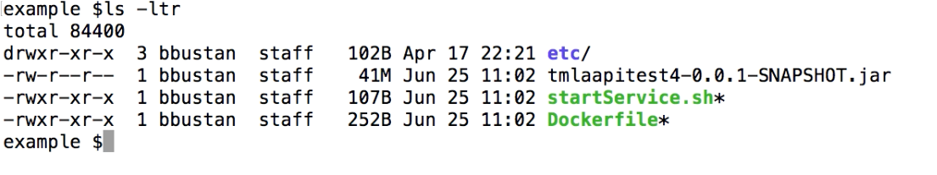
AJSC6 Build Docker Image
How to Build a Docker Image - Example
My local folder contains :
etc – contains configuration files
tmlaapitest4-0.0.1-SNAPSHOT.jar – our AJSC6 JAR file that we’ll be added to the docker image
startService.sh – startup script for the JAR File
Dockerfile – our Dockerfile for building the docker image.
Docker Container Commands

Slide 32
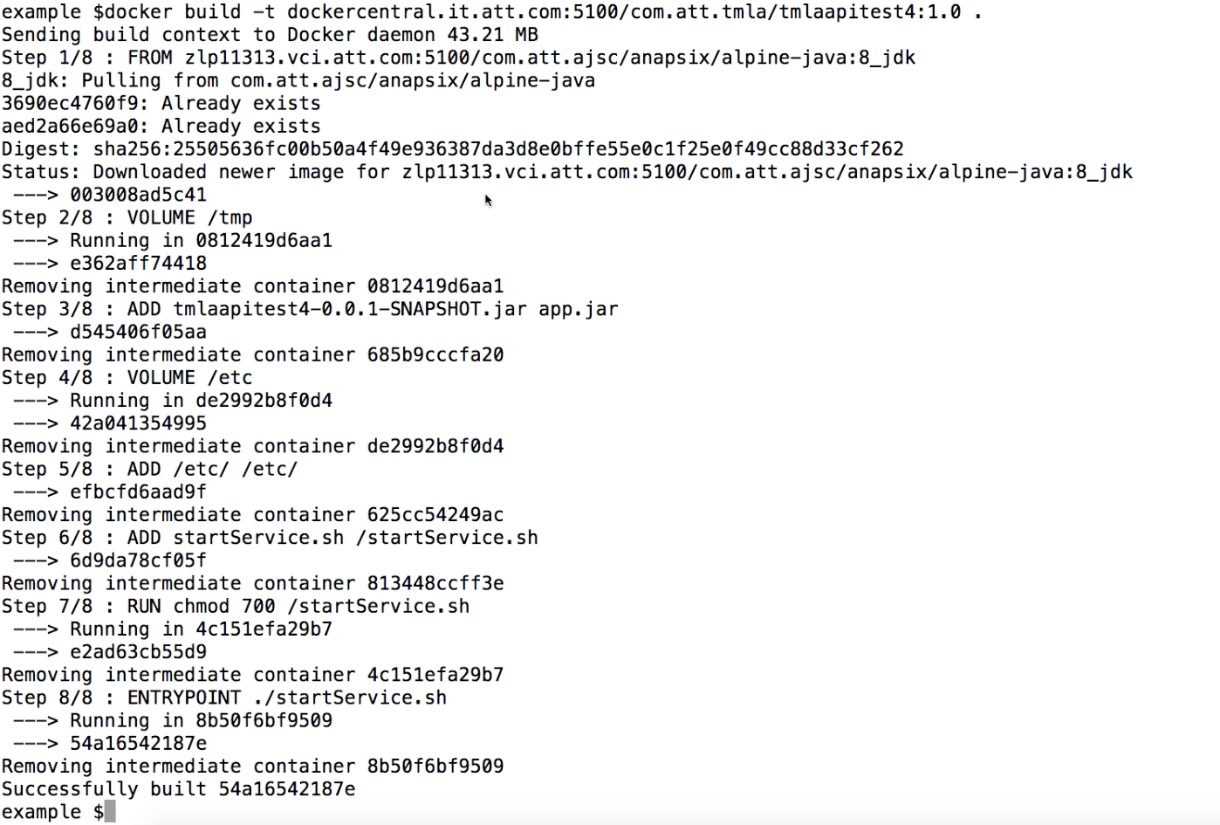
AJSC6 Build Docker Image
How to Build a Docker Image - Example
To build a docker image out of your Dockerfile
Just run Docker Build.
-t refer to tag name
it contains
the Docker registry URL
the namespace
the microservice name and the version.
The “.” at the ends refer to the location of the Dockerfile.
as part of the Jenkins pipeline into one artifact called the “Docker image.”
This image can be deployed on any host running Docker engine / Kubernetes.
Docker Container Commands

Slide 33
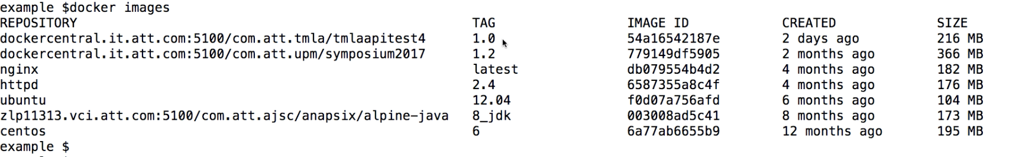
AJSC6 Build Docker Image
How to Build a Docker Image - Example
After the build commands ends, you may run ”docker images” and see, in your local disk, both the base image and the new image created.
Docker Container Commands

Slide 34
AT&T Docker Registry
The 5 building blocks
Choose Base Image
Create Dockerfile
Build image
Upload image to AT&T registry
Start container
Docker Container Commands
Notes:
Now that the Docker image was created successfully, upload it to the AT&T Docker Registry (Hub).
First Step - Completed - Choose your Base Image.
The container requires an OS. This is called the “Base Image."
It is the OS running inside the container, and many vendors have already created light-weight images that can be used, such as Centos, Apache and more.
In AJSC6, we’re using Base Image from Alpine distribution.
Looking at a bakery, this would be like choosing which type of cake you want to bake…cheesecake, chocolate, marble, etc..
Second Step - Completed - Create a Dockerfile
A Dockerfile is a text document that contains all the commands a user can call upon to assemble an image.
Looking at a bakery, this would be similar to a cake recipe.
Third Step - Completed - Build your Docker Image
Once creating the Dockerfile, we can now build our Docker image (such as RPM or Debian package).
Looking at a bakery, this would be like putting the cake batter into the oven to bake the cake.
Fourth Step - Upload your Docker Image to Docker Registry
Usually, we like to upload our image to a central location where our servers can pull it from.
This is called the Docker Register or Docker Hub.
Looking at the bakery, this would be like putting the cake on a shelf in your bakery shop.

Slide 35
AT&T Docker Registry
Why do we need Docker Registry?
There are two options to push a Docker images. The first one is using the Docker push command.
But before you can push it, you should run the Docker login command to register in the registry.
For example:
Docker login -u <MechID>@<NameSpace> -p <password> Dockercentral.it.att.com:5100
The output should be: Login Succeeded
Now you can run the Docker push command to upload the image into AT&T Docker Registry:
Docker push Dockercentral.it.att.com:5100/<Namespace>/<Application Name>:<Version>
Docker Container Commands
Notes:
Docker Registry is used to save your Docker images in a central location.
Once uploaded to Docker Registry, those images can be pulled automatically on your different environments automatically as part of the Docker start command.
This ensures rapid deployment without the need to FTP the image to a location in advance.
There are two options to push a Docker images.
The first one is using the Docker push command.
Before you can push it, you should run the Docker login command to register in the registry.
Another approach is to using Docker plugin for Maven, which CDP uses.
The MVN command get additional parameter: Docker:push
The complete command can be found under your code repository home directory in “Jenkinsfile” file in the stage “Publish Artifact.”
The Jenkins file location is on your root source code repository.
In Kubernetes, the Login details are already configure as a “secret.”

Slide 36
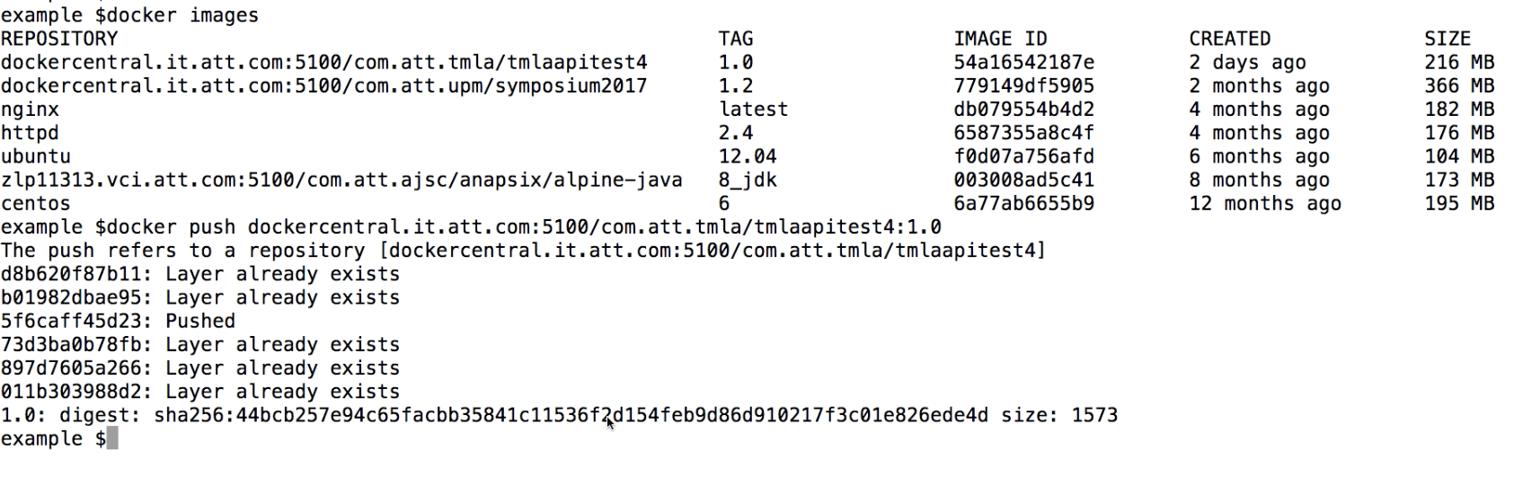
AJSC6 Build Docker Image
Push Docker Image - Example
In this example we’re pushing the image which we created earlier to AT&T Docker registry.
Note: you should run ”docker login” command first.
Docker Container Commands

Slide 37
Start your Docker Container
The 5 Building Blocks
Choose Base Image
Create Dockerfile
Build image
Upload image to AT&T registry
Start container
Docker Container Commands
Notes:
Now that our Docker images was created successfully, let’s go a head and upload it to the AT&T Docker Registry (Hub).
First Step - Completed – Choose your Base Image
The container requires an OS. This is called the “Base Image."
It is the OS running inside the container, and many vendors have already created light-weight images that can be used, such as Centos, Apache and more.
In AJSC6, we’re using Base Image from Alpine distribution.
Looking at a bakery, this is like choosing which type of cake you want to bake…, cheesecake, chocolate, marble, etc..
Second Step - Completed - Create a Dockerfile
A Dockerfile is a text document that contains all the commands a user can call upon to assemble an image.
Looking at a bakery, this would be similar to the cake recipe.
Third Step - Completed - Build your Docker Image
Once we created the Dockerfile, we can now build our Docker image (such as RPM or Debian package).
Looking at a bakery, this would be like putting the cake batter into the oven to bake the cake.
Fourth Step - Completed - Upload your Docker Image to Docker Registry
Usually, we like to upload our image to a central location where our servers can pull it from.
This is called the Docker Register or Docker Hub.
Looking at the bakery, this would be like putting the cake on a shelf in your bakery shop.
Fifth Step - Start your Docker Image
This command initiates the Docker container and pulls the Docker image that the containers will use.
Looking at a bakery, this would be like the customer who buys the cake.

Slide 38
Start your Docker Container
How do I start my Docker container?
Docker container can be started in different ways. The concentration here is on the Docker run command:
Docker run -t -d -v <Host mountpoint>:<Docker mountpoint> -p 8500:8500 --env-file=<external configuration file> --name <Docker name> <Docker Image>
Docker Container Commands
Notes:
In order to start your Docker container you should use the Docker Run command.
Here is the Docker Run command explanation:
--tty (-t) – Tell the process that a terminal is present. This affects how the process outputs data and how it treats signals such as (Ctrl-C).
--detached (-d) – Run in detached mode, you can attach again with Docker attach
--env-file – Set all environment variables in env-file
--volume (-v) – Mount host filesystem into the Docker filesystem.
--publish (-p) - Publish a container's port(s) to the host
--name - Assign a name to the container
The last argument should be the name of the Docker image pushed earlier to the Docker registry.
In CDP, Kubernetes is being used. The main idea is the same, but instead of using a command line with all arguments, Kubernetes uses YAML files to describe all arguments, the CDP Jenkins will execute the following script to deploy and run the Docker container:
In the code repository under k8s directory:./deploy.sh
More information about CDP Kubernetes can be found on the following course, CDP410.

Slide 39
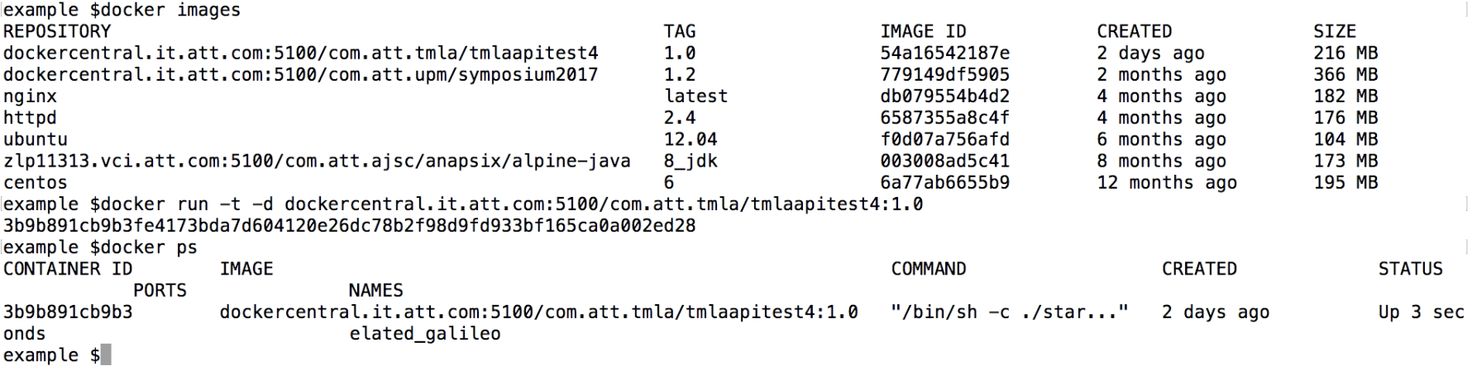
AJSC6 Build Docker Image
Start a container – Example #1 – AJSC6
In the following example we’ll run the Docker image we created using Docker run command , this is a simple example the Docker run use two options parameters:
-t : Allocate a pseudo-tty
-d : Run the container in the background in a “detached” mode
And at the end of the command is the Docker image.
You can verify if the Docker container is running using “Docker ps” command.
Docker Container Commands

Slide 40
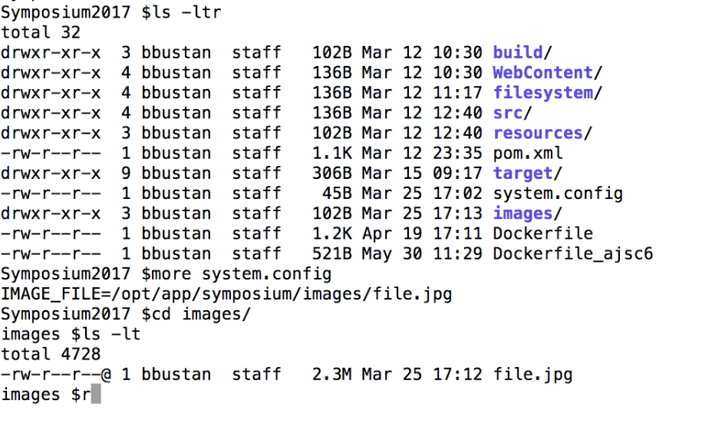
AJSC6 Build Docker Image
Start a container – Example #2 – Symposium2017
My local folder contains :
Images directory which contain an image I would like to mount into the container
System.config file contains key value pairs for a configuration we would like to expose inside the container as shell environment variables
Filesystem directory contains stop/start scripts
Dockerfile – our Dockerfile for building the docker image
Docker Container Commands

Slide 41
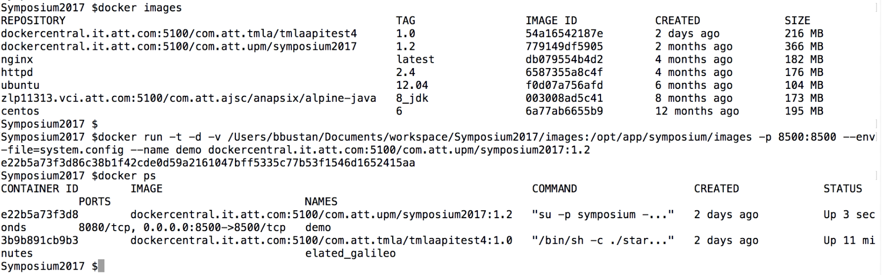
AJSC6 Build Docker Image
Start a container – Example #2 – Symposium2017
Another example for Docker run with more parameters :
-t : Allocate a pseudo-tty
-d : Run the container in the background in a “detached” mode
-v : Mount host filesystem to container internal filesystem
-p : Bind host port to container internal port
-env-file : Contains a file with key/value pairs to be expose insider the container as environment variables.
--name : A name for our container
And at the end of the command is the Docker image.
Docker Container Commands

Slide 42
Start your Docker Container
Commands for Interacting with Containers
Docker create - creates a container but does not start it
Docker run - creates and starts a container
Docker stop - stops it
Docker start - will start it again
Docker ps - check which containers are running
Docker restart - restarts a container
Docker rm - deletes a container
Docker kill - sends a SIGKILL to a container
Docker attach - will connect to a running container
Docker wait - blocks until container stops
Docker exec - executes a command in a running container
Docker Container Commands
Notes:
Docker create - creates a container but does not start it.
Docker run - creates and starts a container.
Docker stop - stops it.
Docker start - will start it again.
Docker ps - check which containers are running
Docker restart - restarts a container.
Docker rm - deletes a container.
Docker kill - sends a SIGKILL to a container.
Docker attach - will connect to a running container.
Docker wait - blocks until container stops.
Docker exec - executes a command in a running container.

Slide 43
Check Your Progress

Slide 44
Exercises
A+
Docker Container Commands
There is only one way to build a Docker image. | True/False
Docker images can be create only by certified personnel. | True/False
AT&T Docker registry is used to store your Docker images in a central location. | True/False
The Docker run command can automatically pull Docker images from the AT&T Docker registry. | True/False
Notes:
Docker Containers: Overview
Dockerfile
Docker Container Commands
AT&T Eco – AJSC6 Pipeline

Slide 45
Contents
Docker Containers: Overview
AJSC6 Dockerfile
Docker Container Commands
AT&T Eco – AJSC6 Pipeline
Notes:
Docker Containers: Overview
AJSC6 Dockerfile
Docker Container Commands
AT&T Eco – AJSC6 Pipeline

Slide 46
AT&T Eco – AJSC Pipeline
Jenkins
In AT&T Eco, Jenkins is responsible for the creation an distribution of the Docker image.
It uses Maven Docker plugin to run the Docker build and deploy phase. This stage is also known as “Publish Artifact.”
Maven command example from Jenkinsfile:
'mvn -X -DskipTests -Dmaven.test.skip=true -Dhttps.protocols="TLSv1" -Djavax.net.ssl.trustStore="/opt/app/aft/aftswmnode/etc/cacerts.jks" -Djavax.net.ssl.trustStorePassword="f22723cffdbd2fff1cb3c558677a7684" -Djavax.net.ssl.keyStore="/opt/app/aft/aftswmnode/etc/cacerts.jks" -Djavax.net.ssl.keyStorePassword="f22723cffdbd2fff1cb3c558677a7684" -s $MAVEN_SETTINGS -U docker:build docker:push'
AT&T Eco – AJSC6 Pipeline
Notes:
The Steps we saw in the previous chapters are important to understand the steps of building and running a Docker containers.
In CDP AT&T Eco, use Jenkins to automate the build and deploy phase by using Maven plugins, which encapsulates the Docker BUILD and Docker PUSH commands.
In Jenkins pipeline, the part of the build responsible for this part is “Publish Artifact.”
It will build your Docker image out of your Dockerfile,
…then uploaded it to AT&T Docker registry so
…it can be later pulled part of “Deploy to Staging” part.

Slide 47
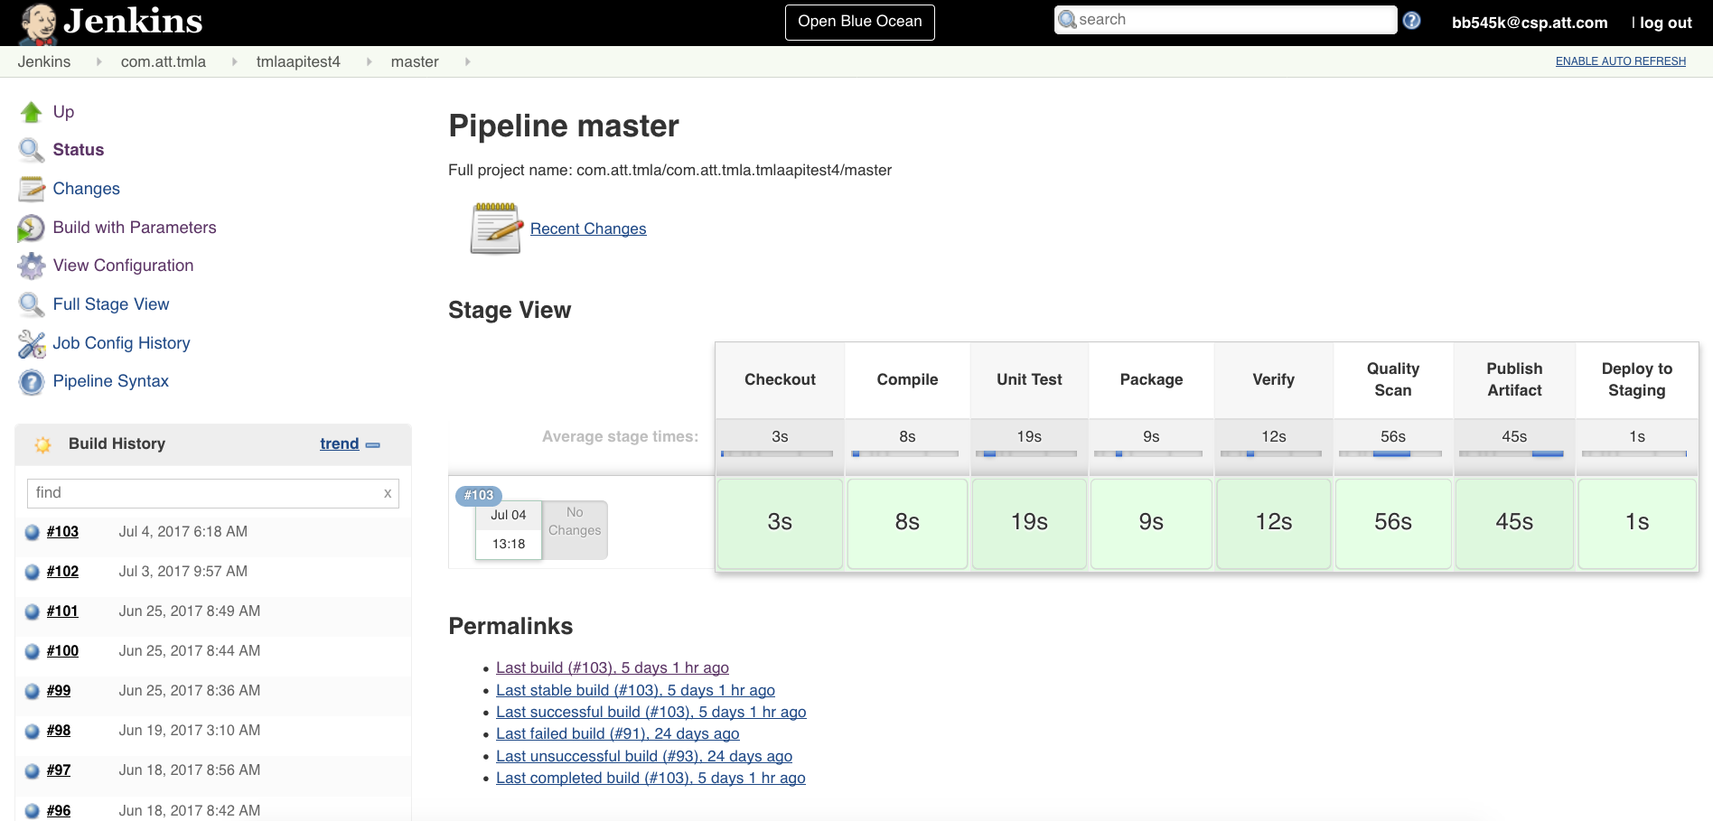
AT&T Eco – AJSC Pipeline
Jenkins – BUILD_DEPLOY example
AT&T Eco – AJSC6 Pipeline
Notes:
When triggering new pipeline using BUILD_DEPLOY option it will trigger 8 steps : Checkout , Compile , Unit Test , Package , Verify , Quality Scan , Publish Artifact and Deploy to Staging.
The steps which are related to Docker build and push commands is Publish Artifact” step , during this step the Docker images is being created and pushed to AT&T Docker registry.
The last step on the pipeline is “Deploy to Staging” in this step Jenkins will trigger a script that we’ll deploy our Docker image in a Kubernetes environment .

Slide 48
AT&T Eco – AJSC Pipeline
Summary
Using Dockers containers simplifies our code deployment.
Using AT&T Eco simplify the manual use of Docker commands and create us a complete Jenkins deployment pipeline.
AT&T Eco – AJSC6 Pipeline
Notes:
As you can see throughout the course, Docker containers are easy to use for your application and especially for AJSC6 deployment.
There is almost no post configuration you should perform when using AT&T Eco for AJSC6 Docker deployment.
In the next course CDP410 – Using Kubernetes, you’ll become familiar with the last phase of the Jenkins pipeline ”Deploy to Staging” and also how to manage your Docker deployment on CDP Kubernetes cluster.

Slide 49
Check Your Progress

Slide 50
Exercises
A+
AT&T Eco - AJSC Pipeline
Which of the following Jenkins steps are related to Docker Build & Deploy? | Checkout Unit Test Compile Package Verify Publish Artifact Quality Scan Deploy to Staging
Notes:
Docker Containers: Overview
Dockerfile
Docker Container Commands
AT&T Eco – AJSC6 Pipeline

Slide 51
Answers to Exercises

Slide 52
Exercises
A+
Docker Containers: Overview
What are the main benefits of using Docker containers? (More than one choice). | Rapid deployment Ability to run different Linux versions in the same host system Infrastructure management Almost no performance impact to applications Easy packaging
Docker engine is supported on all Red Hat Linux versions. | True/False
Notes:
Docker Containers: Overview
Dockerfile
Docker Container Commands
AT&T Eco – AJSC6 Pipeline

Slide 53
Exercises
A+
Docker Containers: Overview
Match Layer to function for an AJSC6 Container Architecture in ITO Cloud
Layer One | Infrastructure – Virtual Machine
Layer Two | Operating systems – Red Hat
Layer Three | Docker Engine / Kubernetes Cluster
Layer Four | Docker containers
Notes:
Docker Containers: Overview
Dockerfile
Docker Container Commands
AT&T Eco – AJSC6 Pipeline

Slide 54
Exercises
A+
Dockerfile
Docker runs instructions in a Dockerfile in order, the first instruction must be ‘FROM’. | True/False
The RUN instruction will execute any commands in a new layer on top of the current image and commit the results. | True/False
COPY & ADD commands in Dockerfile are the same. | True/False
Which of the following Docker commands will be used during Docker Run phase? | CMD MAINTAINER RUN COPY EXPOSE ONBUILD
Notes:
Docker Containers: Overview
Dockerfile
Docker Container Commands
AT&T Eco – AJSC6 Pipeline

Slide 55
Exercises
A+
Docker Container Commands
There is only one way to build a Docker image. | True/False
Docker images can be create only by certified personnel. | True/False
AT&T Docker registry is used to store your Docker images in a central location. | True/False
The Docker run command can automatically pull Docker images from the AT&T Docker registry. | True/False
Notes:
Docker Containers: Overview
Dockerfile
Docker Container Commands
AT&T Eco – AJSC6 Pipeline

Slide 56
Exercises
A+
AT&T Eco - AJSC Pipeline
Which of the following Jenkins steps are related to Docker Build & Deploy? | Checkout Unit Test Compile Package Verify Publish Artifact Quality Scan Deploy to Staging
Notes:
Docker Containers: Overview
Dockerfile
Docker Container Commands
AT&T Eco – AJSC6 Pipeline

